Slide 1
Architecture Diagram
ESP32
Power supply
Relay Module
Lighting system
Android APP
Fan System
Watering System
DHT11 sensor
Moisture sensor
WEB Server/ Application
My SQL Database.
LCD Monitor(Maybe)

Slide 2
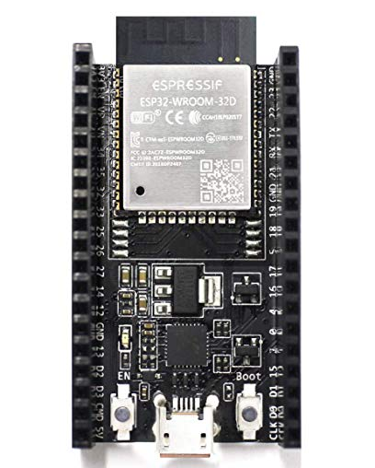

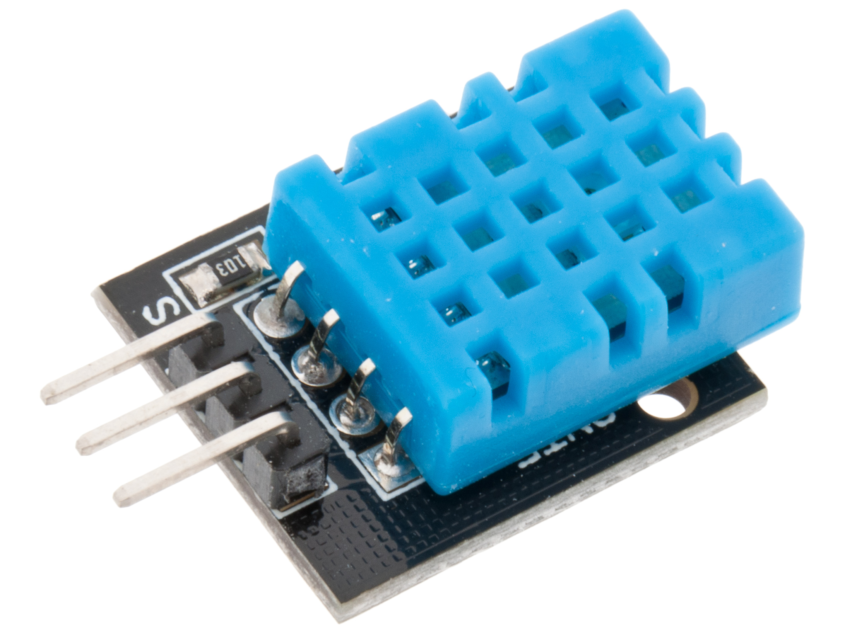
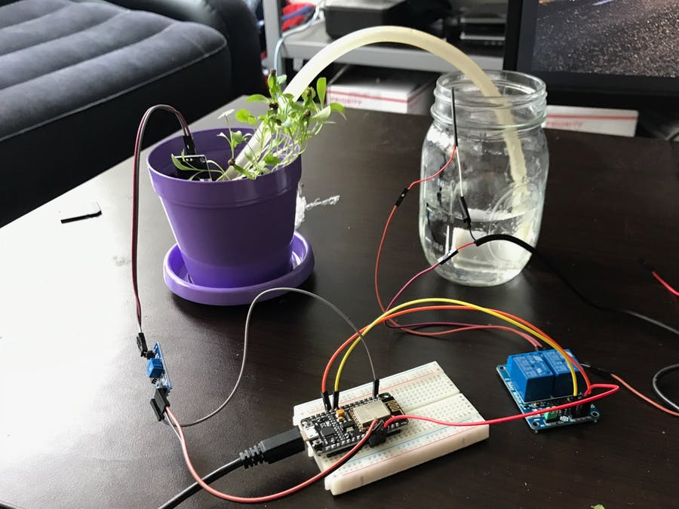
ESP32 board used
Next semester I plan to implement most of the hardware and actually build the mini green house itself. I will hopefully get to implement features such as a lighting and fan system and a watering system to the project.
To date I have developed the weather station of the green house. To this I have developed a Esp32 basic web server which displays the humidity and temperature of the green house.
Work Done to date
Smart Greenhouse
Future Plans
Weather Station
Auto - Watering
I have also developed a SQL data base using Xamp, MySQL and my php admin. The data base stores all the readings from the dht11 and allows the user to access the readings through a simple html page and table.
Auto – Water was an automatic watering system I developed in third year project. It allowed crops or plants to be watered through an android app. I hope to implement something from this project to my smart greenhouse in the future.
DHT11 sensor used

